Slide 1
GUI Events
Chapter 15
Notes:
Marquee with 3-D perspective rotation
(Intermediate)
To reproduce the effects on this slide, do the following:
On the Home tab, in the Slides group, click Layout, and then click Blank.
On the Home tab, in the Drawing group, click Shapes, and then under Rectangles click Rectangle (first option from the left). On the slide, drag to draw a rectangle.
Under Drawing Tools, on the Format tab, in the Size group, do the following:
In the Shape Height box, enter 3.12”.
In the Shape Width box, enter 7.67”.
On the Home tab, in the Drawing group, click the arrow next to Shape Fill, and then click No Fill.
On the Home tab, in the Drawing group, click the arrow next to Shape Outline, and then click No Outline.
Right-click the rectangle, and then click Edit Text.
Enter text in the text box, and then select the text. On the Home tab, in the Font group, select Franklin Gothic Medium from the Font list, enter 50 in the Font Size box, and then click Bold.
On the Home tab, in the Paragraph group, click Center to center the text in the text box.
Under Drawing Tools, on the Format tab, in the WordArt Styles group, click the arrow next to Text Fill, point to Gradient, and then click More Gradients.
In the Format Text Effects dialog box, click Text Fill in the left pane, select Gradient fill in the Text Fill pane, and then do the following:
In the Type list, select Linear.
Click the button next to Direction, and then click Linear Down (first row, second option from the left).
In the Angle box, enter 90°.
Under Gradient stops, click Add gradient stop or Remove gradient stop until three stops appear in the drop-down list.
Also under Gradient stops, customize the gradient stops that you added as follows:
Select the first stop in the slider, and then do the following:
In the Position box, enter 0%.
Click the button next to Color, click More Colors, and then in the Colors dialog box, on the Custom tab, enter values for Red: 80, Green: 80, Blue: 80.
Select the next stop in the slider, and then do the following:
In the Position box, enter 49%.
Click the button next to Color, click More Colors, and then in the Colors dialog box, on the Custom tab, enter values for Red: 89, Green: 89, Blue: 89.
Select the last stop in the slider, and then do the following:
In the Position box, enter 50%.
Click the button next to Color, and then under Theme Colors click Black, Text 1 (first row, second option from the left).
Also in the Format Text Effects dialog box, click Shadow in the left pane. In the Shadow pane, click the button next to Presets, and then under Outer click Offset Center (second row, second option from the left).
On the Home tab, in the Drawing group, click Shapes, and then under Rectangles click Rounded Rectangle (second option from the left). On the slide, drag to draw a rounded rectangle.
Select the rounded rectangle. Under Drawing Tools, on the Format tab, in the Size group, do the following:
In the Shape Height box, enter 3.12”.
In the Shape Width box, enter 7.67”.
Drag the yellow diamond adjustment handle at the top of the rounded rectangle to adjust the amount of rounding on the corners.
Under Drawing Tools, on the Format tab, in the Shape Styles group, click the arrow next to Shape Fill, point to Gradient, and then click More Gradients.
In the Format Shape dialog box, click Fill in the left pane, select Gradient fill in the Fill pane, and then do the following:
In the Type list, select Linear.
Click the button next to Direction, and then click Linear Right (first row, fourth option from the left).
In the Angle box, enter 0°.
Under Gradient stops, click Add gradient stop or Remove gradient stop until two stops appear in the slider.
Also under Gradient stops, customize the gradient stops that you added as follows:
Select the first stop in the slider, and then do the following:
In the Position box, enter 0%.
Click the button next to Color, and then under Theme Colors click White, Background 1 (first row, first option from the left).
Select the last stop in the slider, and then do the following:
In the Position box, enter 100%.
Click the button next to Color, and then under Theme Colors click White, Background 1, Darker 25% (fourth row, first option from the left).
Also in the Format Shape Effects dialog box, click Line Color in the left pane. In the Line Color pane, select No line.
Select the rounded rectangle. On the Home tab, in the Clipboard group, click the arrow to the right of Copy, and then click Duplicate.
Select the duplicate rounded rectangle. On the Home tab, in the Drawing group, click the arrow next to Shape Fill, and then click No Fill.
On the Home tab, in the Drawing group, click the arrow next to Shape Outline, and then under Theme Colors click White, Background 1 (first row, first option from the left).
On the Home tab, in the Drawing group, click the arrow next to Shape Outline, point to Weight, and then click More Lines. In the Format Shape dialog box, click Line Style in the left pane, and then do the following in the Line Style pane:
In the Width box enter 10 pt.
Click the button next to Dash type, and then click Round Dot (second option from the top).
In the Cap type list, select Round.
On the Home tab, in the Drawing group, click Shape Effects, point to Glow, and then do the following:
Under Glow Variations, click Accent color 1, 11 pt glow (third row, first option from the left).
Point to More Glow Colors, and then click More Colors. In the Colors dialog box, on the Custom tab, enter values for Red: 255, Green: 233, Blue: 33.
Under Drawing Tools, on the Format tab, in the Size group, do the following:
In the Shape Height box, enter 3.53”.
In the Shape Width box, enter 8.05”.
On the Home tab, in the Drawing group, click Shapes, and then under Lines click Line (first option from the left).
Press and hold SHIFT to constrain to a straight, horizontal line, and then drag to draw a horizontal line on the slide.
Select the line. Under Drawing Tools, on the Format tab, in the Size group, in the Shape Width box, enter 7.67”.
On the Home tab, in the Drawing group, click the arrow next to Shape Outline, and then do the following:
Under Theme Colors, click Black, Text 1, Lighter 50% (second row, second option from the left).
Point to Weight, and then click 1 1/2 pt.
Select the line. On the Home tab, in the Clipboard group, click the arrow to the right of Copy, and then click Duplicate. Repeat the process for a total of eight straight lines.
On the Home tab, in the Editing group, click Select, and then click Selection Pane.
In the Selection and Visibility pane, select the first rectangle that contains text. On the Home tab, in the Drawing group, click Arrange, and then click Bring to Front.
Also in the Selection and Visibility pane, press and hold CTRL and select all three rectangle objects. On the Home tab, in the Drawing group, click Arrange, point to Align, and then do the following:
Click Align to Slide.
Click Align Center.
Click Align Middle.
Drag each of the straight lines onto the gradient-filled rectangle, spacing them vertically as evenly as possible.
In the Selection and Visibility pane, press and hold CTRL and select all eight straight connector objects (the lines). On the Home tab, in the Drawing group, click Arrange, point to Align, and then do the following:
Click Align Selected Objects.
Click Distribute Vertically.
Click Align Center.
Press CTRL+A to select all of the objects on the slide. On the Home tab, in the Drawing group, click Arrange, and then click Group.
Select the group. On the Home tab, in the Drawing group, click Shape Effects, point to 3-D Rotation, and then under Perspective click Perspective Right (first row, third option from the left).
Drag the group slightly to the right on the slide to position it in the center.
To reproduce the background effects on this slide, do the following:
Right-click the slide background area, and then click Format Background. In the Format Background dialog box, click Fill in the left pane, select Gradient fill in the Fill pane, and then do the following:
In the Type list, select Linear.
Click the button next to Direction, and then click Linear Down (first row, second option from the left).
Under Gradient stops, click Add gradient stop or Remove gradient stop until four stops appear in the slider.
Also under Gradient stops, customize the gradient stops that you added as follows:
Select the first stop in the slider, and then do the following:
In the Position box, enter 0%.
Click the button next to Color, and then under Theme Colors click Dark Blue, Text 2 (first row, fourth option from the left).
Select the next stop in the slider, and then do the following:
In the Position box, enter 15%.
Click the button next to Color, and then under Theme Colors click Black, Text 1, Lighter 5% (sixth row, second option from the left).
Select the next stop in the slider, and then do the following:
In the Position box, enter 85%.
Click the button next to Color, and then under Theme Colors click Black, Text 1, Lighter 5% (sixth row, second option from the left).
Select the last stop in the slider, and then do the following:
In the Position box, enter 100%.
Click the button next to Color, and then under Theme Colors click Dark Blue, Text 2 (first row, fourth option from the left).

Slide 2
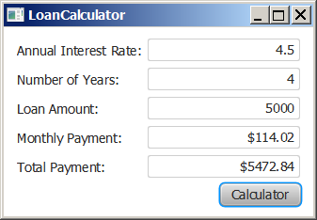
Motivations
Suppose you want to write a GUI program that lets the user enter a loan amount, annual interest rate, and number of years and click the Compute Payment button to obtain the monthly payment and total payment. How do you accomplish the task? You have to use event-driven programming to write the code to respond to the button-clicking event.
LoanCalculator
Run

Slide 3
Topics
To describe events, event sources, and event classes
To define handler classes, register handler objects with the source object, and write the code to handle events
To write programs to deal with MouseEvents
To write programs to deal with KeyEvents
To use the Animation, Transitions and Timeline classes

Slide 4
Procedural vs. Event-Driven Programming
Procedural programming is executed in procedural order.
In event-driven programming, code is executed upon activation of events.

Slide 5
The Trinity of GUI Elements
Components -Handlers– Events
First you create a Component
This could be a button or a label etc.
Next you have to use an Event source which will activate
a Handler that will perform an activity

Slide 6
Components
We have already learned how to do buttons, labels, text boxes etc.
Now we want to use those items to generate some programmatic event.
Once all of the Components are built we have to link them to the Handlers which are linked to the events
So pressing a button results in the Handler attached to the button activating an event chunk of the program to do something- like updating an amount or changing a display

Slide 7
GUI Elements
Handlers – an object that “waits” for an event to occur and responds in way when it does
In designing a GUI-based program we need to establish the relationships between the handler, the event it listens for, and the component that generates the event
In Swing/AWT these were known as Listeners

Slide 8
GUI Elements
To create a Java program that uses a GUI, we must:
instantiate and set up the necessary components,
implement handler classes that define what happens when particular events occur, and
establish the relationship between the handlers and the components that generate the events of interest

Slide 9
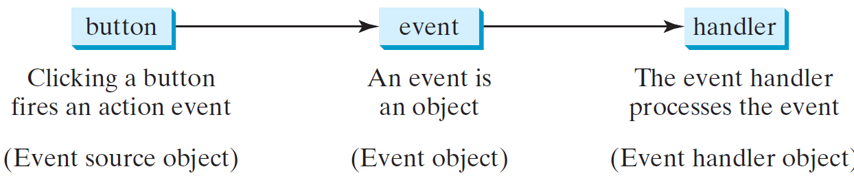
Handling GUI Events
Source object (e.g., button)
Listener object contains a method for processing the event.
9

Slide 10
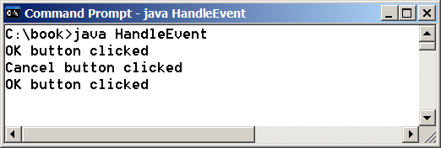
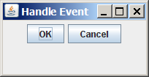
Taste of Event-Driven Programming
The example displays a button in the frame. A message is displayed on the console when a button is clicked.
HandleEvent
Run

Slide 11
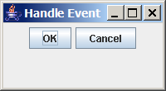
Trace Execution
animation
public class HandleEvent extends Application {
public void start(Stage primaryStage) {
…
OKHandlerClass handler1 = new OKHandlerClass();
btOK.setOnAction(handler1);
CancelHandlerClass handler2 = new CancelHandlerClass();
btCancel.setOnAction(handler2);
…
primaryStage.show(); // Display the stage
}
}
class OKHandlerClass implements EventHandler<ActionEvent> {
@Override
public void handle(ActionEvent e) {
System.out.println("OK button clicked");
}
}
1. Start from the main method to create a window and display it
11

Slide 12
Trace Execution
animation
public class HandleEvent extends Application {
public void start(Stage primaryStage) {
…
OKHandlerClass handler1 = new OKHandlerClass();
btOK.setOnAction(handler1);
CancelHandlerClass handler2 = new CancelHandlerClass();
btCancel.setOnAction(handler2);
…
primaryStage.show(); // Display the stage
}
}
class OKHandlerClass implements EventHandler<ActionEvent> {
@Override
public void handle(ActionEvent e) {
System.out.println("OK button clicked");
}
}
2. Click OK
12

Slide 13
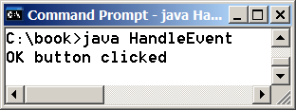
Trace Execution
animation
public class HandleEvent extends Application {
public void start(Stage primaryStage) {
…
OKHandlerClass handler1 = new OKHandlerClass();
btOK.setOnAction(handler1);
CancelHandlerClass handler2 = new CancelHandlerClass();
btCancel.setOnAction(handler2);
…
primaryStage.show(); // Display the stage
}
}
class OKHandlerClass implements EventHandler<ActionEvent> {
@Override
public void handle(ActionEvent e) {
System.out.println("OK button clicked");
}
}
3. Click OK. The JVM invokes the listener’s handle method
13

Slide 14
Events
An event can be defined as a type of signal to the program that something has happened.
The event is generated by external user actions such as mouse movements, mouse clicks, or keystrokes.

Slide 15
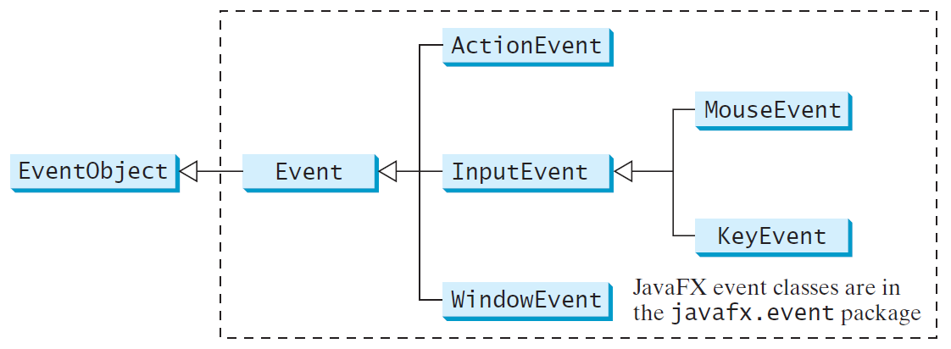
Event Classes

Slide 16
Event Information
An event object contains whatever properties are pertinent to the event. You can identify the source object of the event using the getSource() instance method in the EventObject class. The subclasses of EventObject deal with special types of events, such as button actions, window events, component events, mouse movements, and keystrokes. Table 16.1 lists external user actions, source objects, and event types generated.

Slide 17
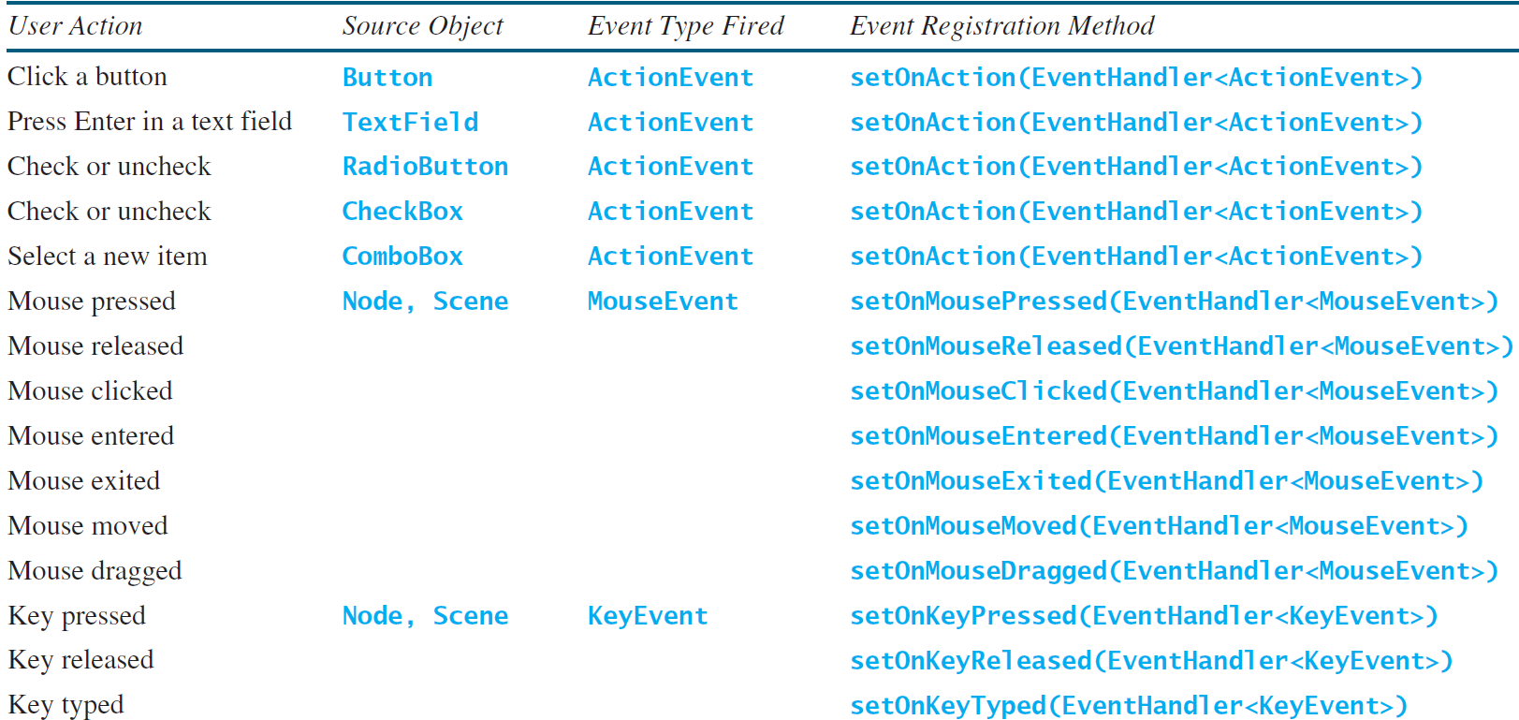
Selected User Actions and Handlers

Slide 18
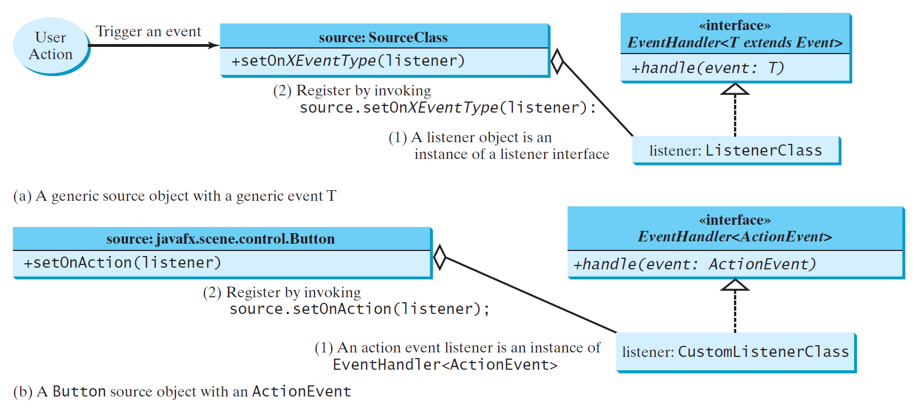
The Delegation Model

Slide 19
The Delegation Model: Example
Button btOK = new Button("OK");
OKHandlerClass handler = new OKHandlerClass();
btOK.setOnAction(handler);

Slide 20
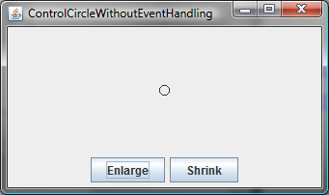
Example: First Version for ControlCircle (no listeners)
Now let us consider to write a program that uses two buttons to control the size of a circle.
ControlCircleWithoutEventHandling
Run

Slide 21
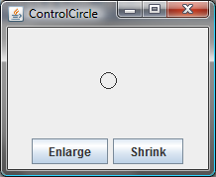
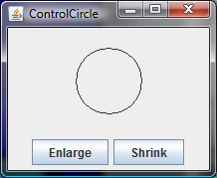
Example: Second Version for ControlCircle (with listener for Enlarge)
Now let us consider to write a program that uses two buttons to control the size of a circle.
ControlCircle
Run

Slide 22
Inner Class Listeners
A listener class is designed specifically to create a listener object for a GUI component (e.g., a button). It will not be shared by other applications. So, it is appropriate to define the listener class inside the frame class as an inner class.

Slide 23
Inner Classes
Inner class: A class is a member of another class.
Advantages: In some applications, you can use an inner class to make programs simple.
An inner class can reference the data and methods defined in the outer class in which it nests, so you do not need to pass the reference of the outer class to the constructor of the inner class.
ShowInnerClass

Slide 24
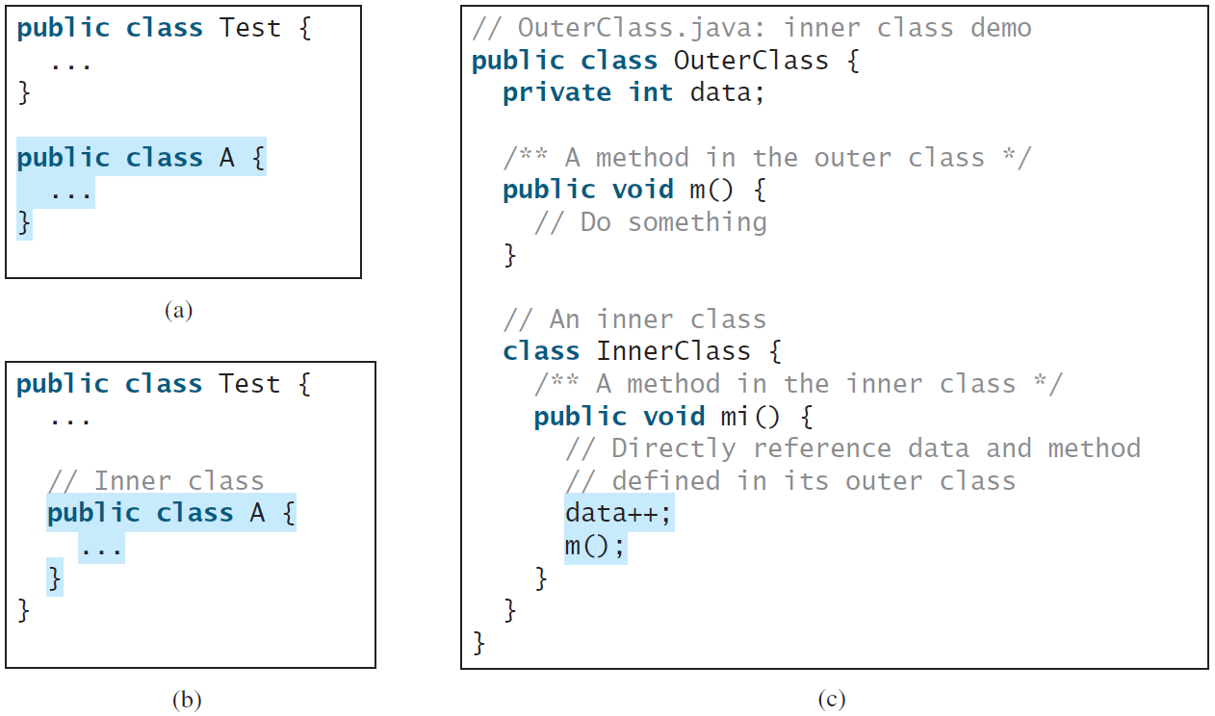
Inner Classes, cont.

Slide 25
Inner Classes (cont.)
Inner classes can make programs simple and concise.
An inner class supports the work of its containing outer class and is compiled into a class named OuterClassName$InnerClassName.class. For example, the inner class InnerClass in OuterClass is compiled into OuterClass$InnerClass.class.

Slide 26
Inner Classes (cont.)
An inner class can be declared public, protected, or private subject to the same visibility rules applied to a member of the class.
An inner class can be declared static. A static inner class can be accessed using the outer class name. A static inner class cannot access nonstatic members of the outer class

Slide 27
Anonymous Inner Classes
An anonymous inner class must always extend a superclass or implement an interface, but it cannot have an explicit extends or implements clause.
An anonymous inner class must implement all the abstract methods in the superclass or in the interface.
An anonymous inner class always uses the no-arg constructor from its superclass to create an instance. If an anonymous inner class implements an interface, the constructor is Object().
An anonymous inner class is compiled into a class named OuterClassName$n.class. For example, if the outer class Test has two anonymous inner classes, these two classes are compiled into Test$1.class and Test$2.class.

Slide 28
Anonymous Inner Classes (cont.)
Inner class listeners can be shortened using anonymous inner classes. An anonymous inner class is an inner class without a name. It combines declaring an inner class and creating an instance of the class in one step. An anonymous inner class is declared as follows:
new SuperClassName/InterfaceName() {
// Implement or override methods in superclass or interface
// Other methods if necessary
}

Slide 29
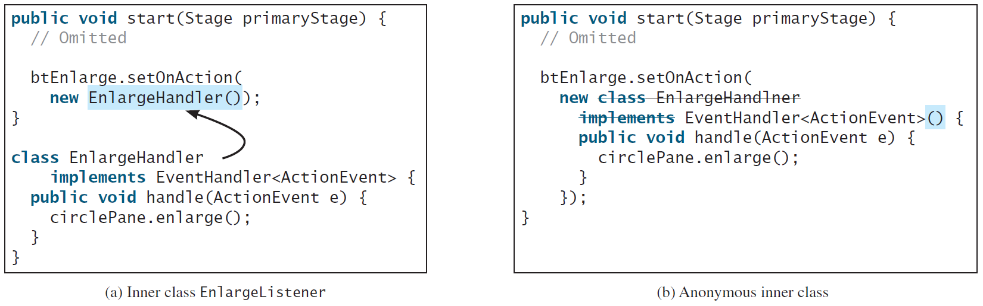
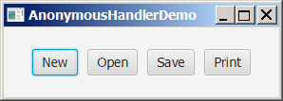
Anonymous Inner Classes (cont.)
AnonymousHandlerDemo
Run

Slide 30
Simplifying Event Handing Using Lambda Expressions
Lambda expression is a new feature in Java 8. Lambda expressions can be viewed as an anonymous method with a concise syntax. For example, the following code in (a) can be greatly simplified using a lambda expression in (b) in three lines.

Slide 31
Basic Syntax for a Lambda Expression
The basic syntax for a lambda expression is either
(type1 param1, type2 param2, ...) -> expression
or
(type1 param1, type2 param2, ...) -> { statements; }
The data type for a parameter may be explicitly declared or implicitly inferred by the compiler. The parentheses can be omitted if there is only one parameter without an explicit data type.

Slide 32
Single Abstract Method Interface (SAM)
The statements in the lambda expression is all for that method. If it contains multiple methods, the compiler will not be able to compile the lambda expression. So, for the compiler to understand lambda expressions, the interface must contain exactly one abstract method. Such an interface is known as a functional interface, or a Single Abstract Method (SAM) interface.
AnonymousHandlerDemo
Run

Slide 33
Problem: Loan Calculator
LoanCalculator
Run

Slide 34
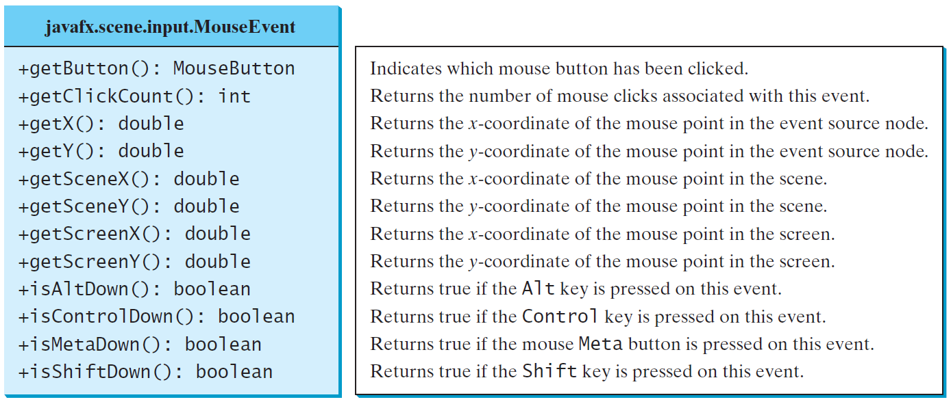
MouseEvent
MouseEventDemo
Run

Slide 35
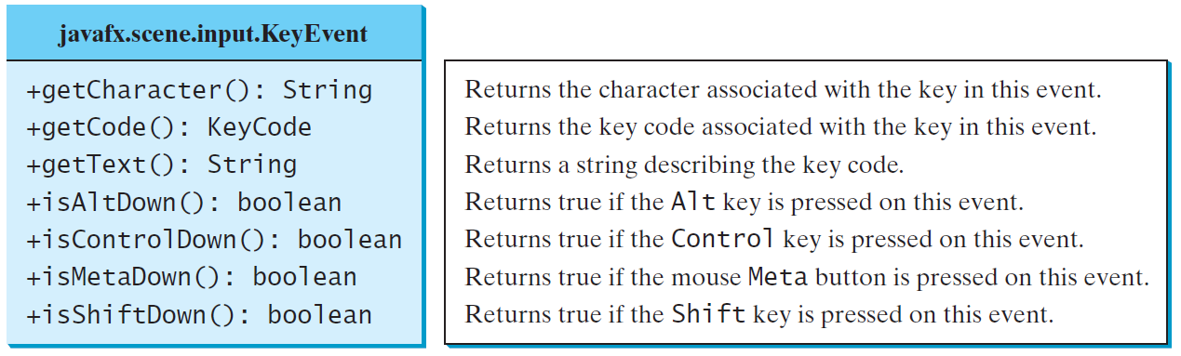
The KeyEvent Class
MouseEventDemo
Run

Slide 36
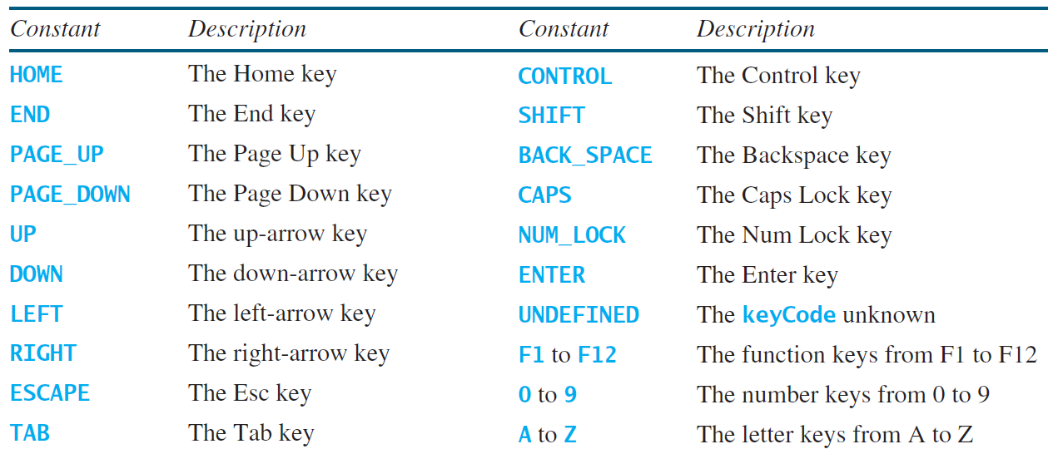
The KeyCode Constants

Slide 37
Example: Control Circle with Mouse and Key
ControlCircleWithMouseAndKey
Run

Slide 38
Listeners for Observable Objects
You can add a listener to process a value change in an observable object.
An instance of Observable is known as an observable object, which contains the addListener(InvalidationListener listener) method for adding a listener. Once the value is changed in the property, a listener is notified. The listener class should implement the InvalidationListener interface, which uses the invalidated(Observable o) method to handle the property value change. Every binding property is an instance of Observable.
ObservablePropertyDemo
Run
DisplayResizableClock
Run

Slide 39
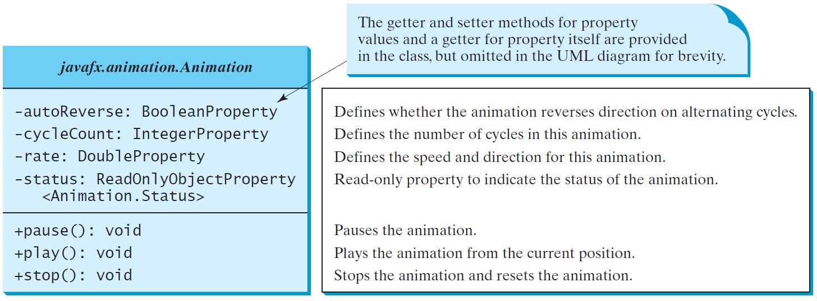
Animation
JavaFX provides the Animation class with the core functionality for all animations.

Slide 40
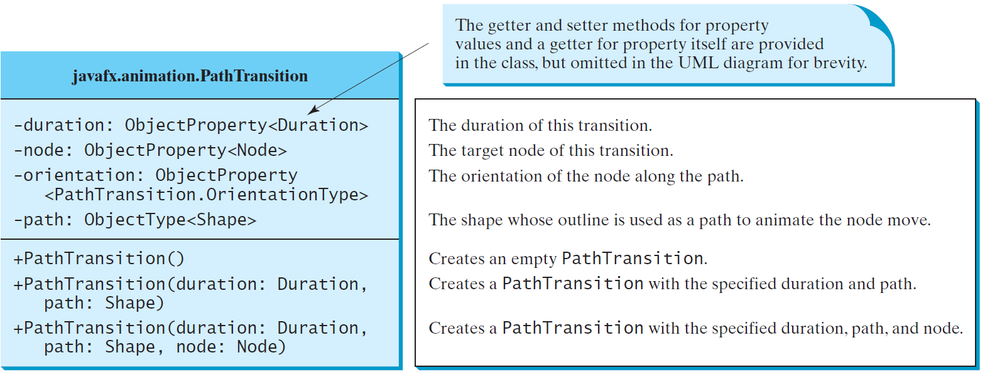
PathTransition
PathTransitionDemo
Run
FlagRisingAnimation
Run

Slide 41
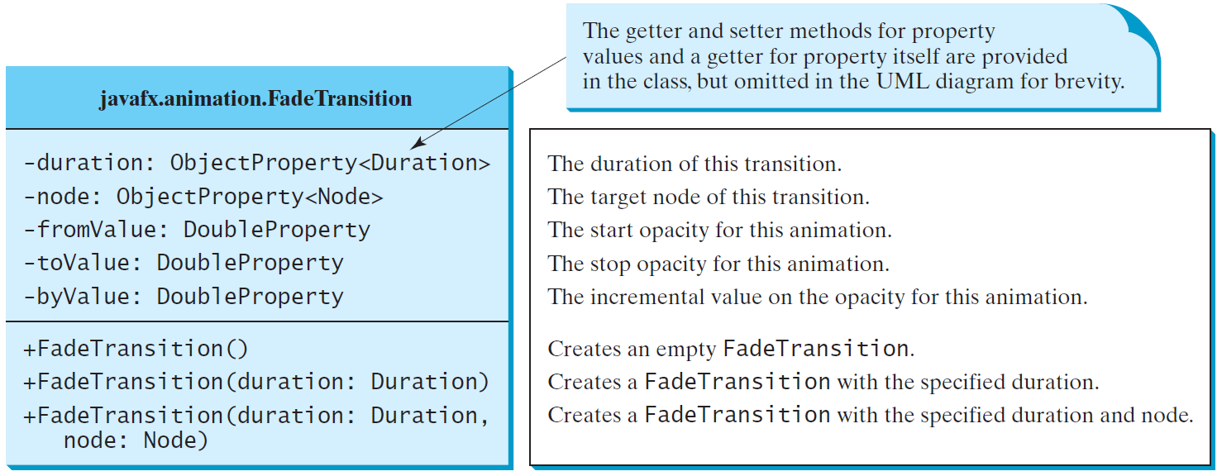
FadeTransition
The FadeTransition class animates the change of the opacity in a node over a given time.
FadeTransitionDemo
Run

Slide 42
Timeline
PathTransition and FadeTransition define specialized animations. The Timeline class can be used to program any animation using one or more KeyFrames. Each KeyFrame is executed sequentially at a specified time interval. Timeline inherits from Animation.
TimelineDemo
Run

Slide 43
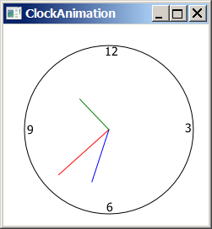
Clock Animation
ClockAnimation
Run

Slide 44
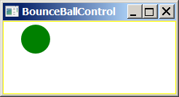
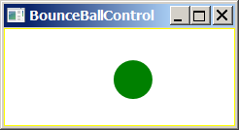
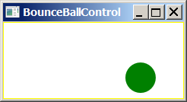
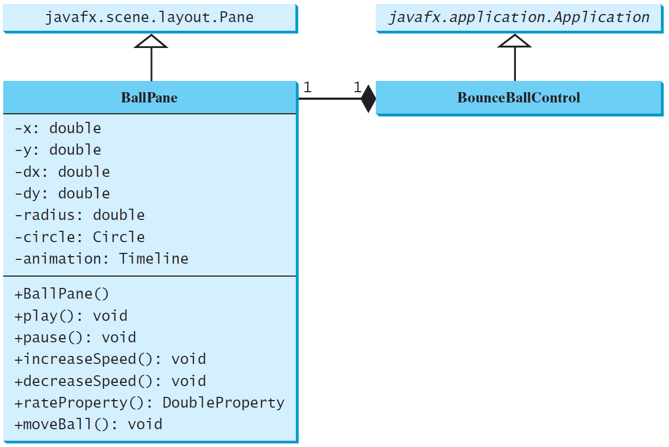
Case Study: Bouncing Ball
BallPane
BounceBallControl
Run

Slide 45
Old School material
From here out are slides to show how things are done in the Swing/AWT world

Slide 46

Push Counter Application

Slide 47
import java.awt.*;
import java.awt.event.*;
import javax.swing.*;
public class PushCounterPanel extends Jpanel {
private int count;
private JButton push;
private JLabel label;
public PushCounterPanel () { //constructor
count = 0;
push = new JButton ("Push Me!");
push.addActionListener (new ButtonListener());
label = new JLabel ("Pushes: " + count);
add (push);
add (label);
setBackground (Color.cyan);
setPreferredSize (new Dimension(300, 40)); }
private class ButtonListener implements ActionListener {
public void actionPerformed (ActionEvent event) {
count++;
label.setText("Pushes: " + count); } } }
Can access the instance variables count and label

Slide 48
Events
An event can be defined as a type of signal to the program that something has happened.
The event is generated by external user actions such as mouse movements, mouse clicks, and keystrokes, or by the operating system, such as a timer.

Slide 49
Event Classes

Slide 50
Event Information
An event object contains whatever properties are pertinent to the event. You can identify the source object of the event using the getSource() instance method in the EventObject class. The subclasses of EventObject deal with special types of events, such as button actions, window events, component events, mouse movements, and keystrokes. Table 15.1 lists external user actions, source objects, and event types generated.

Slide 51
Selected User Actions
Source Event Type User Action Object Generated
Click a button JButton ActionEvent
Click a check box JCheckBox ItemEvent, ActionEvent
Click a radio button JRadioButton ItemEvent, ActionEvent
Press return on a text field JTextField ActionEvent
Select a new item JComboBox ItemEvent, ActionEvent
Window opened, closed, etc. Window WindowEvent
Mouse pressed, released, etc. Component MouseEvent
Key released, pressed, etc. Component KeyEvent

Slide 52
The Delegation Model

Slide 53
The Delegation Model: Adding a Listener to a Component
JButton jbt = new JButton("OK");
ActionListener listener = new OKListener();
jbt.addActionListener(listener);

Slide 54
Selected Event Handlers
Event Class Listener Interface Listener Methods (Handlers) ActionEvent ActionListener actionPerformed(ActionEvent)
ItemEvent ItemListener itemStateChanged(ItemEvent)
WindowEvent WindowListener windowClosing(WindowEvent)
windowOpened(WindowEvent)
windowIconified(WindowEvent)
windowDeiconified(WindowEvent)
windowClosed(WindowEvent)
windowActivated(WindowEvent)
windowDeactivated(WindowEvent)
ContainerEvent ContainerListener componentAdded(ContainerEvent)
componentRemoved(ContainerEvent)MouseEvent MouseListener mousePressed(MouseEvent)
mouseReleased(MouseEvent)
mouseClicked(MouseEvent)
mouseExited(MouseEvent)
mouseEntered(MouseEvent)
KeyEvent KeyListener keyPressed(KeyEvent)
keyReleased(KeyEvent)
keyTypeed(KeyEvent)

Slide 55
Example: First Version for ControlCircle (no listeners)
Now let us consider to write a program that uses two buttons to control the size of a circle.
ControlCircleWithoutEventHandling
Run

Slide 56
Example: Second Version for ControlCircle (with listener for Enlarge)
Now let us consider to write a program that uses two buttons to control the size of a circle.
ControlCircle
Run

Slide 57
Inner Class Listeners
A listener class is designed specifically to create a listener object for a GUI component (e.g., a button). It will not be shared by other applications. So, it is appropriate to define the listener class inside the frame class as an inner class.

Slide 58
Inner Classes (cont.)
Inner classes can make programs simple and concise.
An inner class supports the work of its containing outer class and is compiled into a class named OuterClassName$InnerClassName.class. For example, the inner class InnerClass in OuterClass is compiled into OuterClass$InnerClass.class.

Slide 59
Inner Classes (cont.)
An inner class can be declared public, protected, or private subject to the same visibility rules applied to a member of the class.
An inner class can be declared static. A static inner class can be accessed using the outer class name. A static inner class cannot access nonstatic members of the outer class

Slide 60
Anonymous Inner Classes
An anonymous inner class must always extend a superclass or implement an interface, but it cannot have an explicit extends or implements clause.
An anonymous inner class must implement all the abstract methods in the superclass or in the interface.
An anonymous inner class always uses the no-arg constructor from its superclass to create an instance. If an anonymous inner class implements an interface, the constructor is Object().
An anonymous inner class is compiled into a class named OuterClassName$n.class. For example, if the outer class Test has two anonymous inner classes, these two classes are compiled into Test$1.class and Test$2.class.

Slide 61
Anonymous Inner Classes
Inner class listeners can be shortened using anonymous inner classes. An anonymous inner class is an inner class without a name. It combines declaring an inner class and creating an instance of the class in one step. An anonymous inner class is declared as follows:
new SuperClassName/InterfaceName() {
// Implement or override methods in superclass or interface
// Other methods if necessary
}
AnonymousListenerDemo
Run

Slide 62
Alternative Ways of Defining Listener Classes
There are many other ways to define the listener classes. For example, you may rewrite Listing 16.3 by creating just one listener, register the listener with the buttons, and let the listener detect the event source, i.e., which button fires the event.
DetectSourceDemo
Run

Slide 63
Alternative Ways of Defining Listener Classes
You may also define the custom frame class that implements ActionListener.
FrameAsListenerDemo
Run

Slide 64
Problem: Loan Calculator
LoanCalculator
Run

Slide 65
Mouse and Key Events
Events are also fired when a user interacts with the computer’s mouse and keyboard
Mouse events
mouse events – occur when the user interacts with another component via the mouse. To use, implement the MouseListener interface class
mouse motion events – occur while the mouse is in motion. To use, implement the MouseMotionListener interface class

Slide 66
Mouse Events
Mouse Event | Description
mouse pressed | The mouse button is pressed down
mouse released | The mouse button is released
mouse clicked | The mouse button is pressed down and released without moving the mouse in between
mouse entered | The mouse pointer is moved onto (over) a component
mouse exited | The mouse pointer is moved off of a component
Mouse Motion Event | Description
mouse moved | The mouse is moved
mouse dragged | The mouse is moved while the mouse button is pressed down

Slide 67
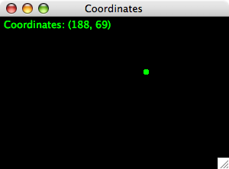
Coordinates Application

Slide 68
import javax.swing.JPanel;
import java.awt.*;
import java.awt.event.*;
public class CoordinatesPanel extends Jpanel {
private final int SIZE = 6; // diameter of dot
private int x = 50, y = 50; // coordinates of mouse press
// Constructor: Sets up this panel to listen for mouse events.
public CoordinatesPanel() {
addMouseListener (new CoordinatesListener());
setBackground (Color.black);
setPreferredSize (new Dimension(300, 200)); }
public void paintComponent (Graphics page){// Draws the dots stored in the list.
super.paintComponent(page);
page.setColor (Color.green);
page.fillOval (x, y, SIZE, SIZE);
page.drawString ("Coordinates: (" + x + ", " + y + ")", 5, 15); }
private class CoordinatesListener implements MouseListener {
public void mousePressed (MouseEvent event) {
x = event.getX();
y = event.getY();
repaint(); }
public void mouseClicked (MouseEvent event) {}
public void mouseReleased (MouseEvent event) {}
public void mouseEntered (MouseEvent event) {}
public void mouseExited (MouseEvent event) {}
}/*ends CoordinatesListener*/ } /*ends CpprdinatesPanel*/

Slide 69
MouseEvent

Slide 70
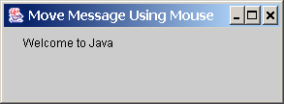
Example: Moving Message Using Mouse
Objective: Create a program to display a message in a panel. You can use the mouse to move the message. The message moves as the mouse drags and is always displayed at the mouse point.
MoveMessageDemo
Run

Slide 71
Handling Mouse Events
Java provides two listener interfaces, MouseListener and MouseMotionListener, to handle mouse events.
The MouseListener listens for actions such as when the mouse is pressed, released, entered, exited, or clicked.
The MouseMotionListener listens for actions such as dragging or moving the mouse.

Slide 72
Extending Adapter Classes
In our previous examples, we’ve created the listener classes by implementing a particular listener interface
An alternative technique for creating a listener class is to use inheritance and extend an adapter class
Each listener interface that contains more than one method has a corresponding adapter class containing empty definitions for all methods in the interface
We can override any event methods we need in our new child class

Slide 73
Extending Adapter Classes
Example
The MouseAdapter class implements the MouseListener interface class and provides empty method definitions for the five mouse event methods
By subclassing MouseAdapter, we can avoid implementing the interface directly
This approach can save us coding time and keep our source code easier to read

Slide 74
Key Events
A key event is generated when the user presses a keyboard key
This allows a program to respond immediately to the user while they are typing or pressing other keyboard keys (such as the arrow or function keys)
In the example starting on the next slide, our DirectionListener class implements the KeyListener interface
KeyListener defines three methods used to respond to keyboard activity

Slide 75
Handling Keyboard Events
To process a keyboard event, use the following handlers in the KeyListener interface:
keyPressed(KeyEvent e)
Called when a key is pressed.
keyReleased(KeyEvent e)
Called when a key is released.
keyTyped(KeyEvent e)
Called when a key is pressed and then released.

Slide 76
The KeyEvent Class
Methods:
getKeyChar() method
getKeyCode() method
Keys:
Home VK_HOME
End VK_END
Page Up VK_PGUP
Page Down VK_PGDN
etc...

Slide 77
The KeyEvent Class, cont.

Slide 78
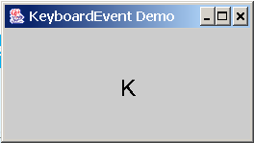
Example: Keyboard Events Demo
Objective: Display a user-input character. The user can also move the character up, down, left, and right using the arrow keys.
KeyEventDemo
Run

Slide 79
Timers
Timers do not have a visual representation, but are a GUI component
Timers are defined by the Timer class and are provided to help manage an activity over time
A timer object generates an action event at regular intervals

Slide 80
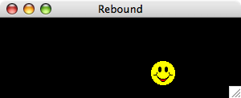
Rebound Application

Slide 81
//Rebound program Starts with a Driver program with main method
import java.awt.*;
import java.awt.event.*;
import javax.swing.*;
public class Rebound {
public static void main (String[] args) {
JFrame frame = new JFrame ("Rebound");
frame.setDefaultCloseOperation (JFrame.EXIT_ON_CLOSE);
frame.getContentPane().add(new ReboundPanel());
frame.pack();
frame.setVisible(true); } }

Slide 82
//Panel Class with Constructor using a Listener and Timer
import java.awt.*;
import java.awt.event.*;
import javax.swing.*;
public class ReboundPanel extends Jpanel {
private final int WIDTH = 300, HEIGHT = 100;
private final int DELAY = 20, IMAGE_SIZE = 35;
private ImageIcon image;
private Timer timer;
private int x, y, moveX, moveY;
public ReboundPanel() {
timer = new Timer(DELAY, new ReboundListener());
image = new ImageIcon ("happyFace.gif");
x = 0;
y = 40;
moveX = moveY = 3;
setPreferredSize (new Dimension(WIDTH, HEIGHT));
setBackground (Color.black);
timer.start(); }
public void paintComponent (Graphics page) {
super.paintComponent (page);
image.paintIcon (this, page, x, y); }

Slide 83
// Represents the action listener for the timer.
private class ReboundListener implements ActionListener
{
// Updates the position of the image and possibly the direction
// of movement whenever the timer fires an action event.
public void actionPerformed (ActionEvent event)
{
x += moveX;
y += moveY;
if (x <= 0 || x >= WIDTH-IMAGE_SIZE)
moveX = moveX * -1;
if (y <= 0 || y >= HEIGHT-IMAGE_SIZE)
moveY = moveY * -1;
repaint();
} } }

Slide 84
The Timer Class
Some non-GUI components can fire events. The javax.swing.Timer class is a source component that fires an ActionEvent at a predefined rate.
The Timer class can be used to control animations. For example, you can use it to display a moving message.
AnimationDemo
Run

Slide 85
Clock Animation
In Chapter 13, you drew a StillClock to show the current time. The clock does not tick after it is displayed. What can you do to make the clock display a new current time every second? The key to making the clock tick is to repaint it every second with a new current time. You can use a timer to control how to repaint the clock.
ClockAnimation
Run

